Slide 2
NetDevOps: Automation on Bare Metal Switches
Intro
Pervasive Q&A
What is Open Networking? (Kevin)
Open hardware, ONIE, APD
Automation (Kevin)
In the context of networking gear. Ansible playbooks, puppet manifests, etc
CI/CD in the context of networking (Russ)
Full stack testing (L1-L4 included)
Demo (Russ)
Do about a 10 minute Vagrant/Vbox run and show in GitLab
Success & intentional failure
Extra Demos if needed (Kevin)

Slide 3
Continuous Integration

Slide 4
artisan|ˈärtəzən| noun a person or company that makes a high-quality or distinctive product in small quantities, usually by hand or using traditional methods.
“Artisan working meticulously on a wooden sculpture” by Piseth1 is licensed under CC-BY-SA-3.0
Notes:
Artisanal Networking is the time-consuming, traditional method of managing networks. We’ve been doing this device-by-device configuration method for decades and it needs to stop!
Snowflakes
Excel Templating
Proprietary Network OS
Limited Test / Validation / Review
Limited Configuration Control
Verification with Ping & Traceroute

Slide 5
“Arithmetical machine with neperian cylinders” by René Grillet is licensed under CC-BY-SA-3.0
Notes:
Excel Templating

Slide 6
“The Gas Machine” by Emma Marie Anderson is licensed under CC-BY-SA-2.0
Notes:
Ciscocmd / bash/ expect / script

Slide 7
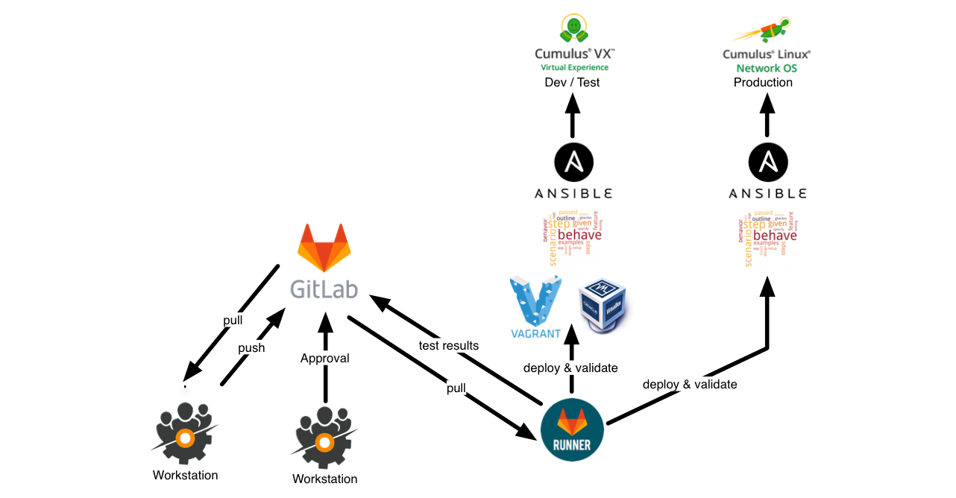
Continuous Delivery

Slide 8
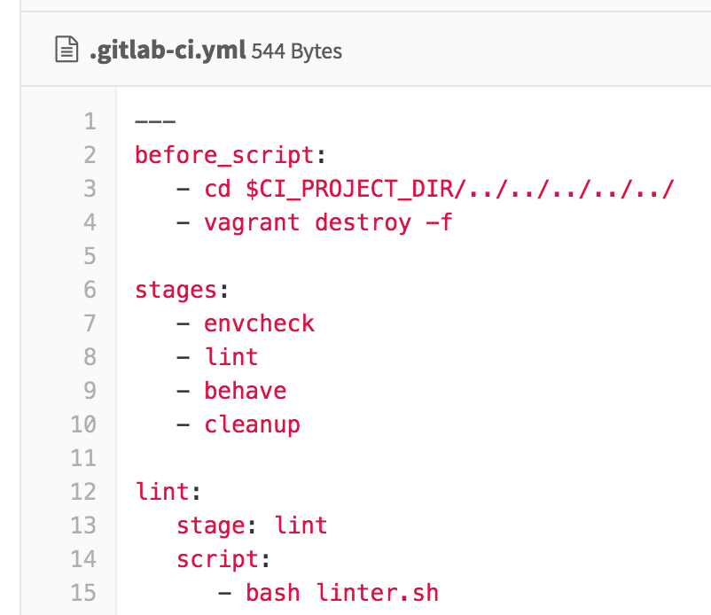
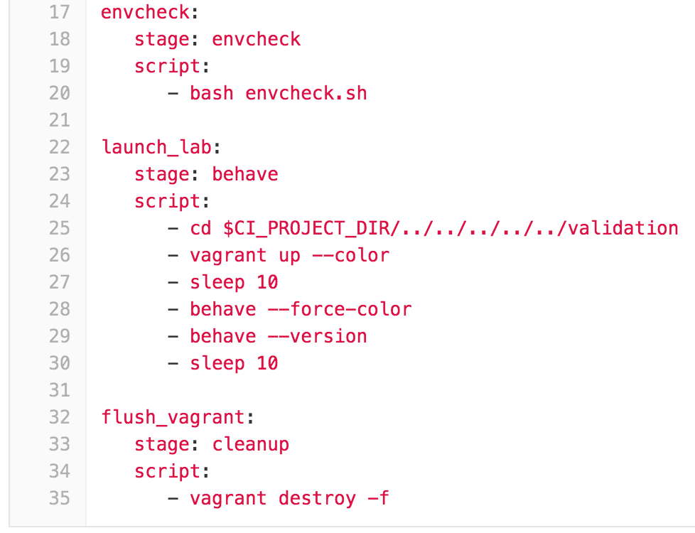
GitLab CI Anatomy

Slide 9
Full Stack Testing
NETWORK
CONFIGURATION
IAAS
CONFIGURATION
SERVICE
CONFIGURATION
STP (or not)
Keystone
winbind
LACP / MLAG
Horizon
Base OS Settings
BGP
Object Storage
splunk
Switches
HEAT
haproxy
Ansible
Subnets
Puppet
Cinder
Chef
syslogd
VLANs
Glance
ruby
Switch Ports
Neutron
Zabbix
VXLAN / Overlay
Nova
MySQL
Routers
Linux OS Image
apache2
Behave
Tempest
Test Kitchen
GitLab CI Runner
Notes:
Snowflakes
Excel Templating
Proprietary Network OS
Limited Test / Validation / Review
Limited Configuration Control
Verification with Ping & Traceroute

